Slide 1


HEALTH CARE FACILITIES ANALYSIS
Empowering Wellness, One Facility At A Time.

Slide 2

ABOUT THE PROJECT
The purpose of this analysis is to come up with health care solutions for the County of Nairobi that align with the SDG3 for Universal Health.
The data used for the analysis is population from https://africaopendata.org/dataset/2019-kenya-population-and-housing-census
The health care data is from:
https://africaopendata.org/dataset/health-facilities-in-kenya

Slide 3
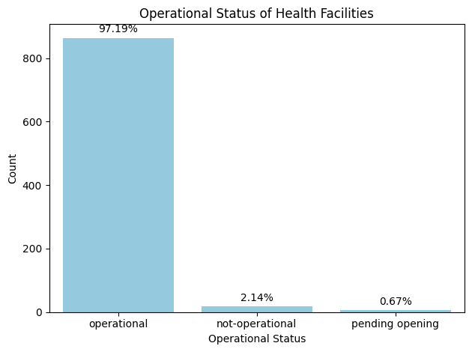
OPERATIONAL STATUS
The majority of health facilities are operational, with about 97.19% of the total. This indicates that a significant portion of the health facilities are functional and currently serving patients.
A small percentage (2.14%) of health facilities are non-operational with an even smaller percentage(0.67) of facilities pending opening

Slide 4

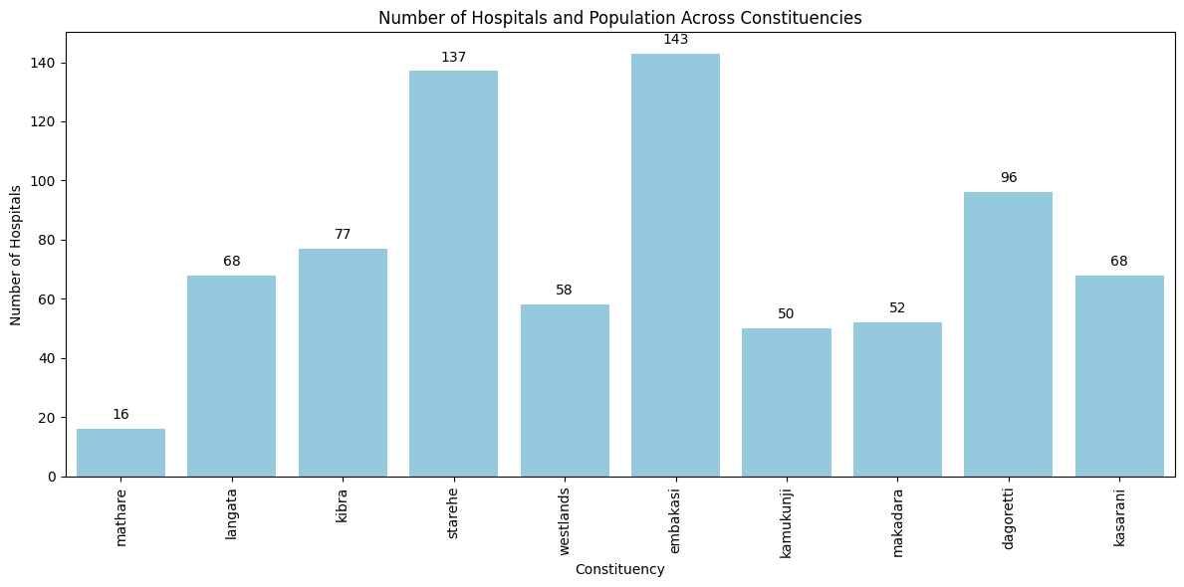
HOSPITALS AND CONSTITUENCIES
Embakasi with a population of 308,654 has the highest number of medical facilities (143) followed by starehe (134) with a population of 185,777.
Despite having the largest population of 988,808 , kamukunji has a very low number of medical facilities (50). Dagoretti on the other hand with the same population has 96 health facilities, which is still low.
Mathare with a population of (206,564) has the lowest distribution of medical facilities (16).

Slide 5
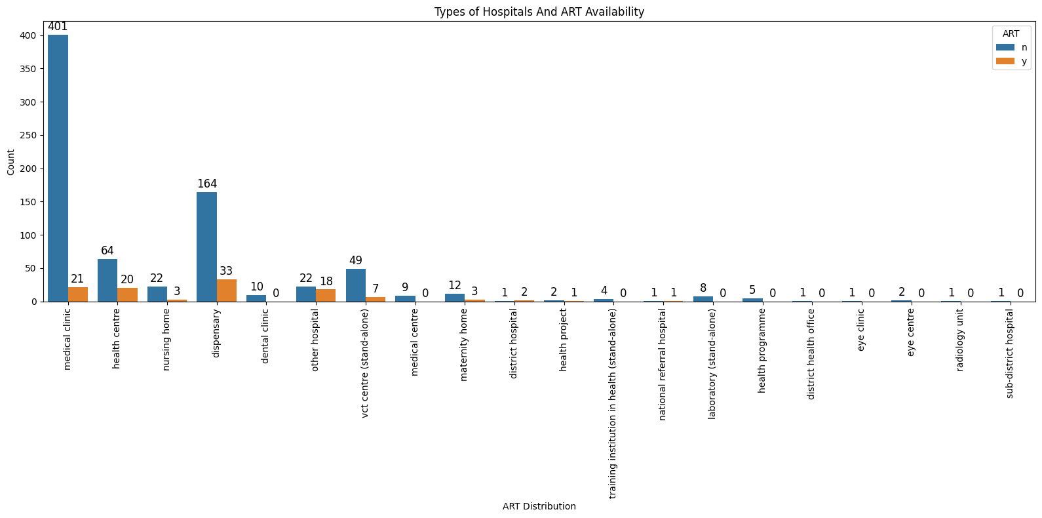
ART SERVICES
67% of district hospitals offer ART services.
Only 23% of health centers offer ART services
No medical center offers ART services.
Only 12% of Nursing Homes offer ART services.
Only 5% of Medical clinics, offer ART services.
Only 20% of maternity homes offer ART services

Slide 6
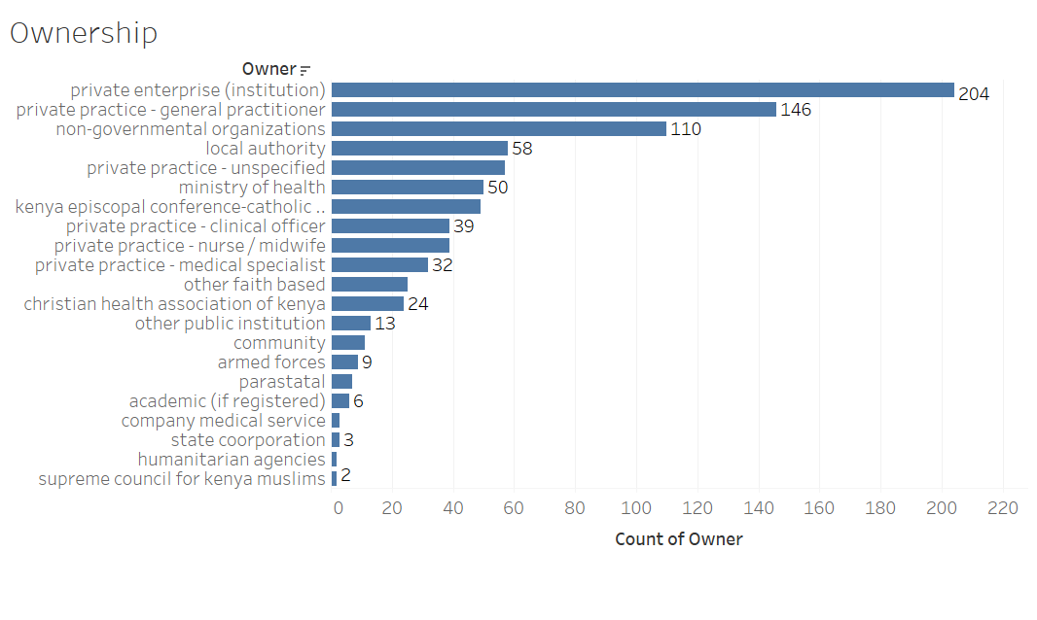
OWNERSHIP
Private sector ownership (private enterprises and private practices) dominates the healthcare facility landscape, accounting for the majority of the ownership.
Smaller categories like Armed Forces, Parastatals, State Corporations, Humanitarian Agencies, and Religious Councils (Supreme Council for Kenya Muslims) own fewer facilities, each with single-digit counts.

Slide 7
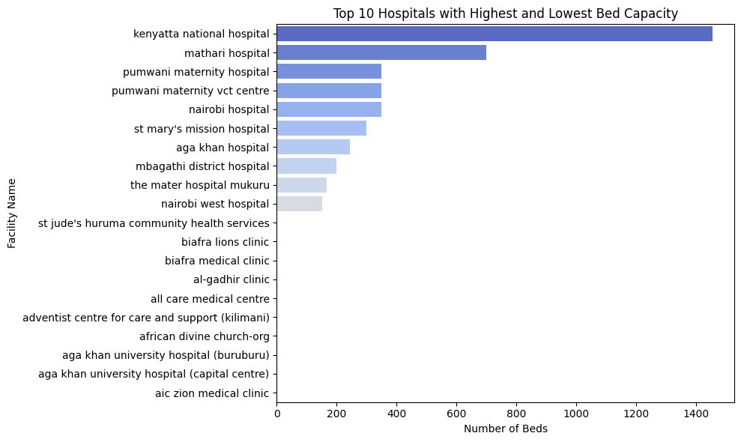
BED CAPACITY
Kenyatta National Hospital has the highest number of beds.
Biafra lions clinic,aga khan university hospital (buruburu) and biafra medical clinic despite having an inpatient department have no bed capacity

Slide 8
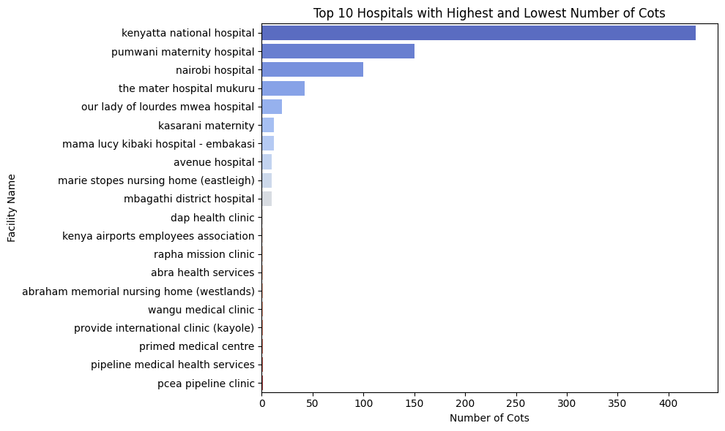
COTS
Kenyatta National Hospital again leads with the highest number of cots, exceeding 400 cots, followed by Pumwani Maternity Hospital and Nairobi Hospital.
Many of the facilities with just one cot do not provide inpatient services including: Dap Health Clinic,Kenya Airports Employees Association, Rapha Mission Clinic, Abra Health Services just to name a few. These facilities are primarily medical clinics or small specialized services (like a maternity home), which may offer outpatient care but lack the resources to provide inpatient care.

Slide 9


OTHER OBSERVATIONS
Medical superintendent are the least officials in charge with a frequency of 25 constituting 2.81% of all positions.
There are 25 nursing home in Nairobi, accounting for 2.81% of the total health facilities.
VCT Centers account for 6.3% of the total healthcare facilities.
The only Radiology Unit is The Plaza X-Ray Services.
Majority of the people in charge of the facilities are nursing officers in-charge, with a frequency of 294 constituting 33.07% of all positions.

Slide 10


RECOMMENDATIONS
Training programs and awareness campaigns for healthcare providers, about the importance of ART services in HIV/AIDS management.
Increase the number of healthcare facilities in highly populated areas to ensure better access to healthcare services for residents.
Provide incentives and support to facilities, to facilitate 24-hour care and weekend services, ensuring access of medical attention to individuals at any time
Invest in the infrastructure of healthcare facilities to support the delivery of C-IMCI services. This can help in promoting development among children under five years of age.
Facilities should consider offering inpatient services. This can act as short term care or temporary accommodation, ensuring quick intervention if necessary and prompt treatment of individuals within the same facility.

Slide 11

SUMMARY
In order to guarantee healthy lives and promote well-being for all people at all ages, the United Nations adopted the Sustainable Development Goal 3.
Implementing these recommendations outlined such as expanding ART services, increasing bed capacity, and providing around-the-clock care,will bring Nairobi closer toachieving Sustainable Development Goal 3 for Universal Health Coverage and improve healthcare outcomes for the residents of Nairobi.

